Slide 1
Securing email: Encrypting messages
ELEC-C7420 - Basic principles in networking

Slide 2
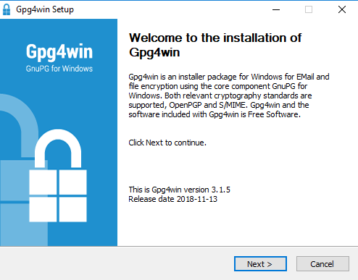
Installing GNU Privacy guard for Windows
Gpg4win enables users to securely transport emails and files with the help of encryption and digital signatures. Encryption protects the contents against an unwanted party reading it. Digital signatures make sure that it was not modified and comes from a specific sender.

Slide 3
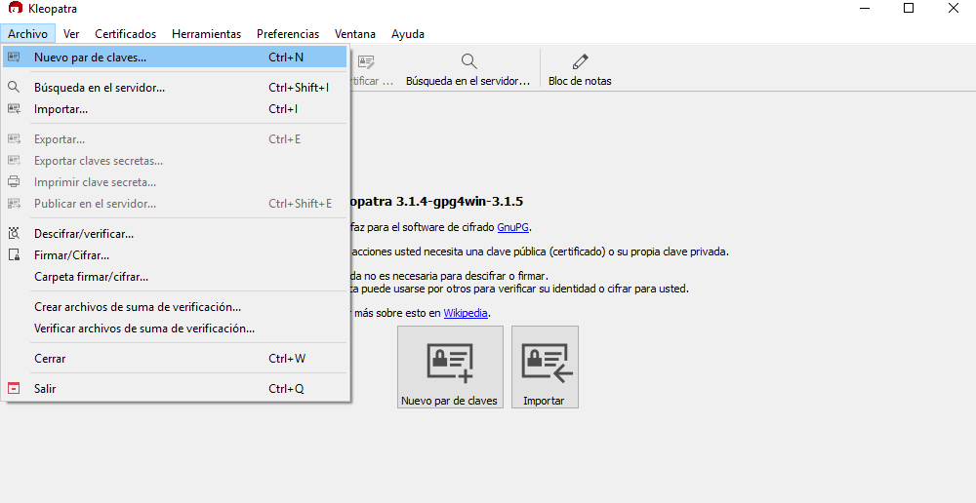
Generating PGP keys
Using Kleopatra we generate the PGP keys

Slide 4
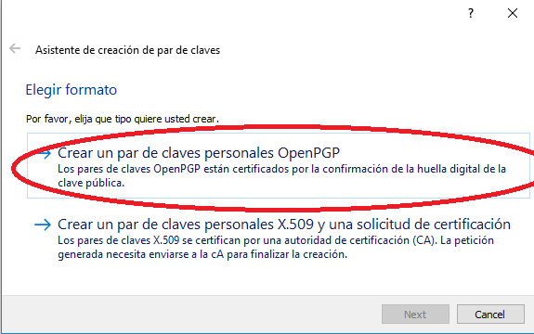
Generating PGP keys

Slide 5
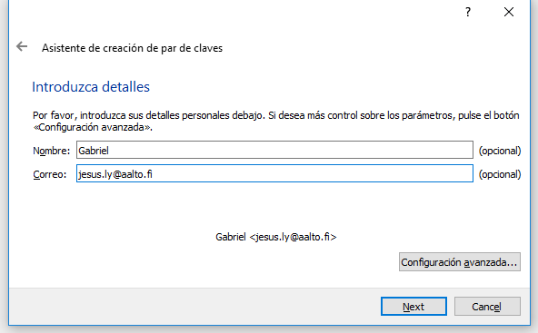
Generating PGP keys
Assigning the details of the keys

Slide 6
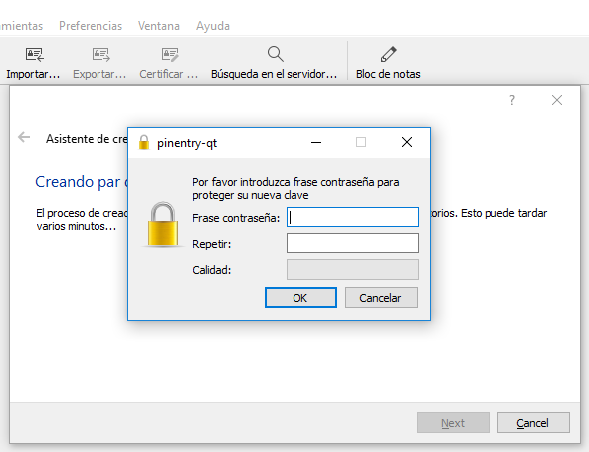
Generating PGP keys

Slide 7
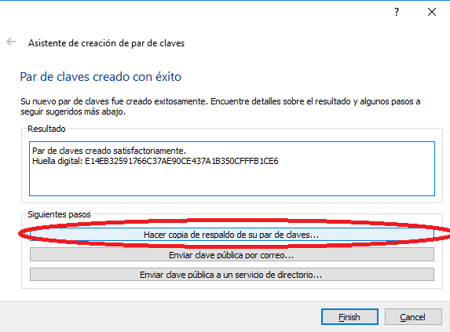
Generating PGP keys

Slide 8
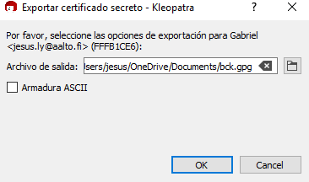
Generating PGP keys
Saving the keys in the computer

